Slide 1

Project Guide:
Mr. Srinivasa A H,
Assistant Professor,
Dept. of CSE,
Dr. AIT
Presented By:
Name: Kumar Vedant,
USN: 1DA19CS078,
Dept. of CSE,
Dr. AIT

Slide 2
Behavioral Cloning
The Art of Replication

Slide 3
Table of Content
01
Introduction
04
Challenges and Limitations
02
Data Collection
Applications
05
03
Training Models
06
Future Development

Slide 4
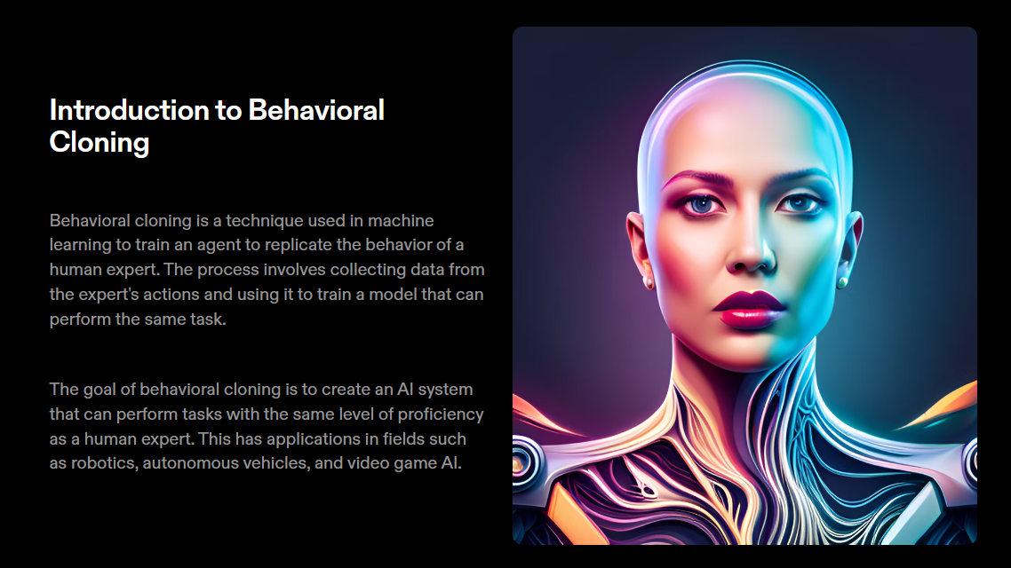

Slide 5
The Intersection
01
02
Machine Learning
Imitation Learning
Notes:
ML: A field of artificial intelligence that enables computers to learn and make predictions or decisions without being explicitly programmed.
IL: aka behavioral cloning is a machine learning technique where models learn to imitate expert behavior by observing and replicating expert demonstrations.

Slide 6
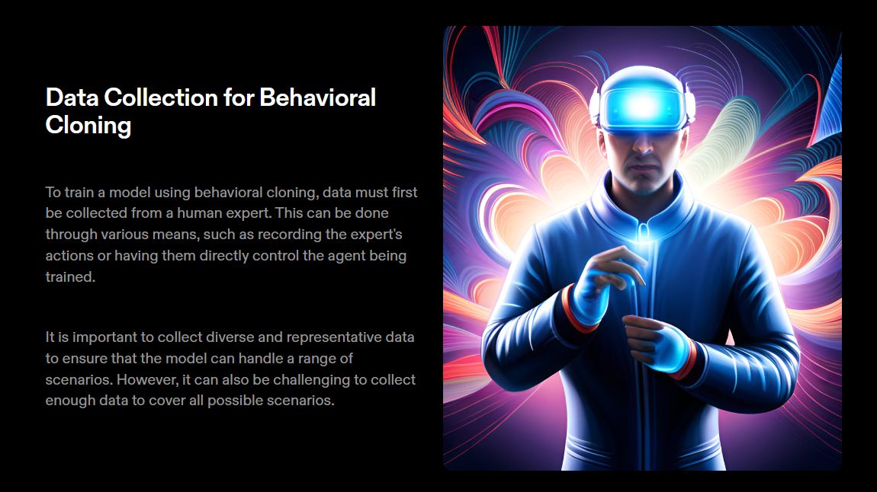

Slide 7
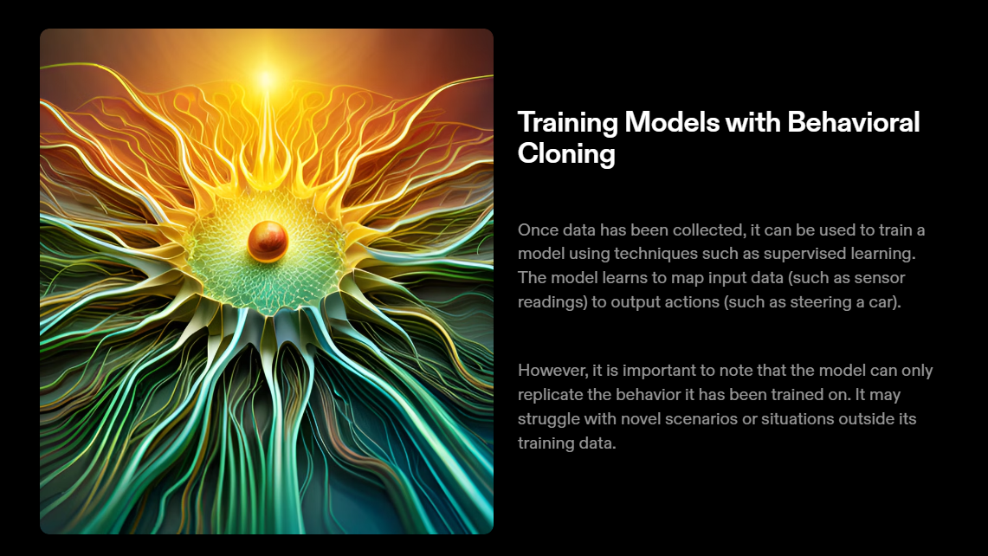

Slide 8
Challenges and Limitations of Behavioral Cloning
Challenges and Limitations
One major challenge of behavioral cloning is the issue of data quality. If the expert’s actions are not representative or contain errors, the model may learn incorrect behavior.
Another limitation is that beavioral cloning only replicates existing behavior, rather than creating new behavior. This can limit the creativity and adaptability of the AI system.

Slide 9
Applications of Behavioral Cloning
Autonomous Driving
To imitate the behavior
of expert human drivers
Some behavioral cloning applications
Robotics
To imitate human demonstrations for tasks
Video Games
To train game playing agents to enhance experiences
Medical Diagnosis
Learning from expert medical practitioners to assist

Slide 10
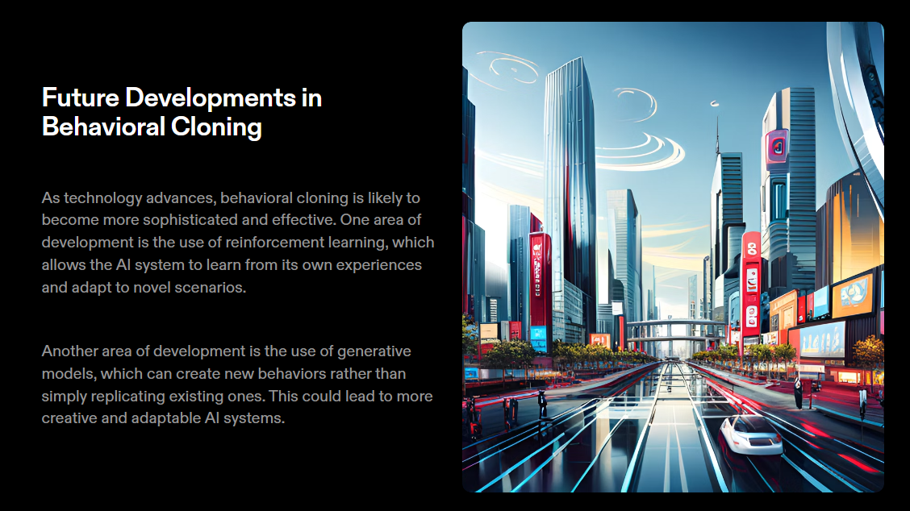

Slide 11
— Alan Turing Father of Modern Computer Science
“A computer would deserve to be called intelligent if it could deceive a human into believing that it was human."

